Slide 1
Design, Develop, Implement, Test & Document Used Car Sales Portal Website
Module Project
Module: Application Development & Process
Start Date : 04 April 2023
End Date : 06 Mei 2023
Submission Date :08/05/2023
Learner Name : Agung Yuda Pratama
Enrollment ID : bdse0922-076
Presentation Date :

Slide 2
Contents
Document History
Version Number | Effective Date of release | Summary of Included Changes | Author

Slide 3
Contents
Contents
S. No. | Description
01 | List of software used
02 | Business Process
03 | Project Plan
04 | Stages of Risk Based Testing models
05 | Types of risks
06 | Risk Based Testing Strategies
07 | Qualitative and Quantitative Risk Analysis
08 | Security Testing
09 | Test plans and Test cases
10 | Logs of Test Results
11 | Modifications of fail Test Cases
12 | Effectiveness of RBT strategy
13 | Project Results

Slide 4

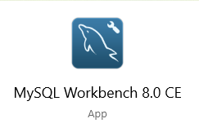

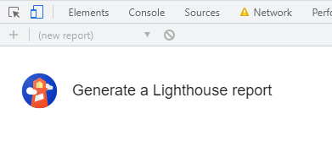
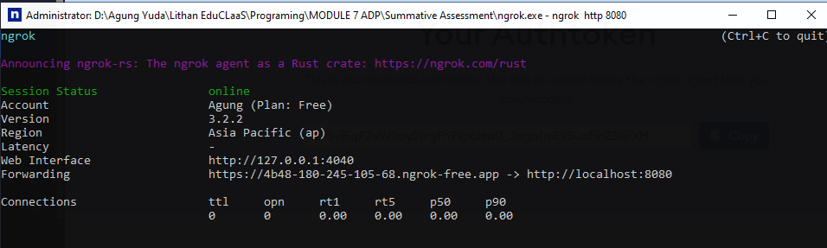
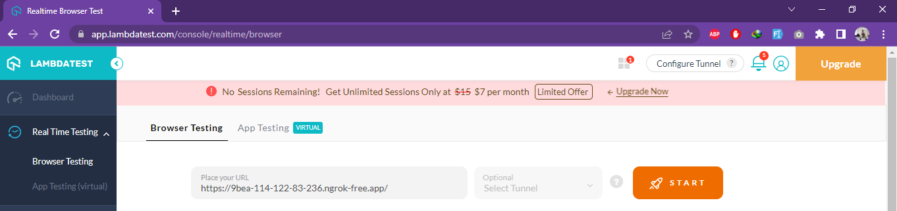
1. List of software used
SpringToolSuite
MySQL
WORD
Chrome DevTools
NGROK
LambdaTest

Slide 5
2. Business Process
Scenario 1 - Post Car
1. To access the used car sales platform, type http://localhost:8080 into your browser.
2. To register as a new user, click "Register" and provide your name, username, email address, and password.
3. A registration success message with a link to the login page will be displayed to the user. 4. On the login page, enter your registered username and password.
5. Following that, the user will view the main page with a list of all the cars listed by other users.
6. To list a car for sale, click "Sell Now" on the homepage, enter the vehicle's name, model, price, make, year, registration date, and a photo, and then click "Post."
7. A post success message with a link to the automobile detail page will be visible to the user.
Scenario 2- Search Car
1. To access the used car sales platform, type http://localhost:8080 into your browser.
2. To register as a new user, click "Register" and fill out the required fields (name, username, email, and password).
3. The user will get a notice that says "Register Success" and a link to the login page. 4. Log in using your registered username and password.
5. The user will next see the homepage, which includes a list of all the cars listed by other users.
6. The user can look for an automobile by using the search bar in the header.
7. The user can look up cars by make, model, price, and registration
8. Click "search" and type "car make year 1967"
9. The user will see a page with all of the cars listed that match the search term.

Slide 6
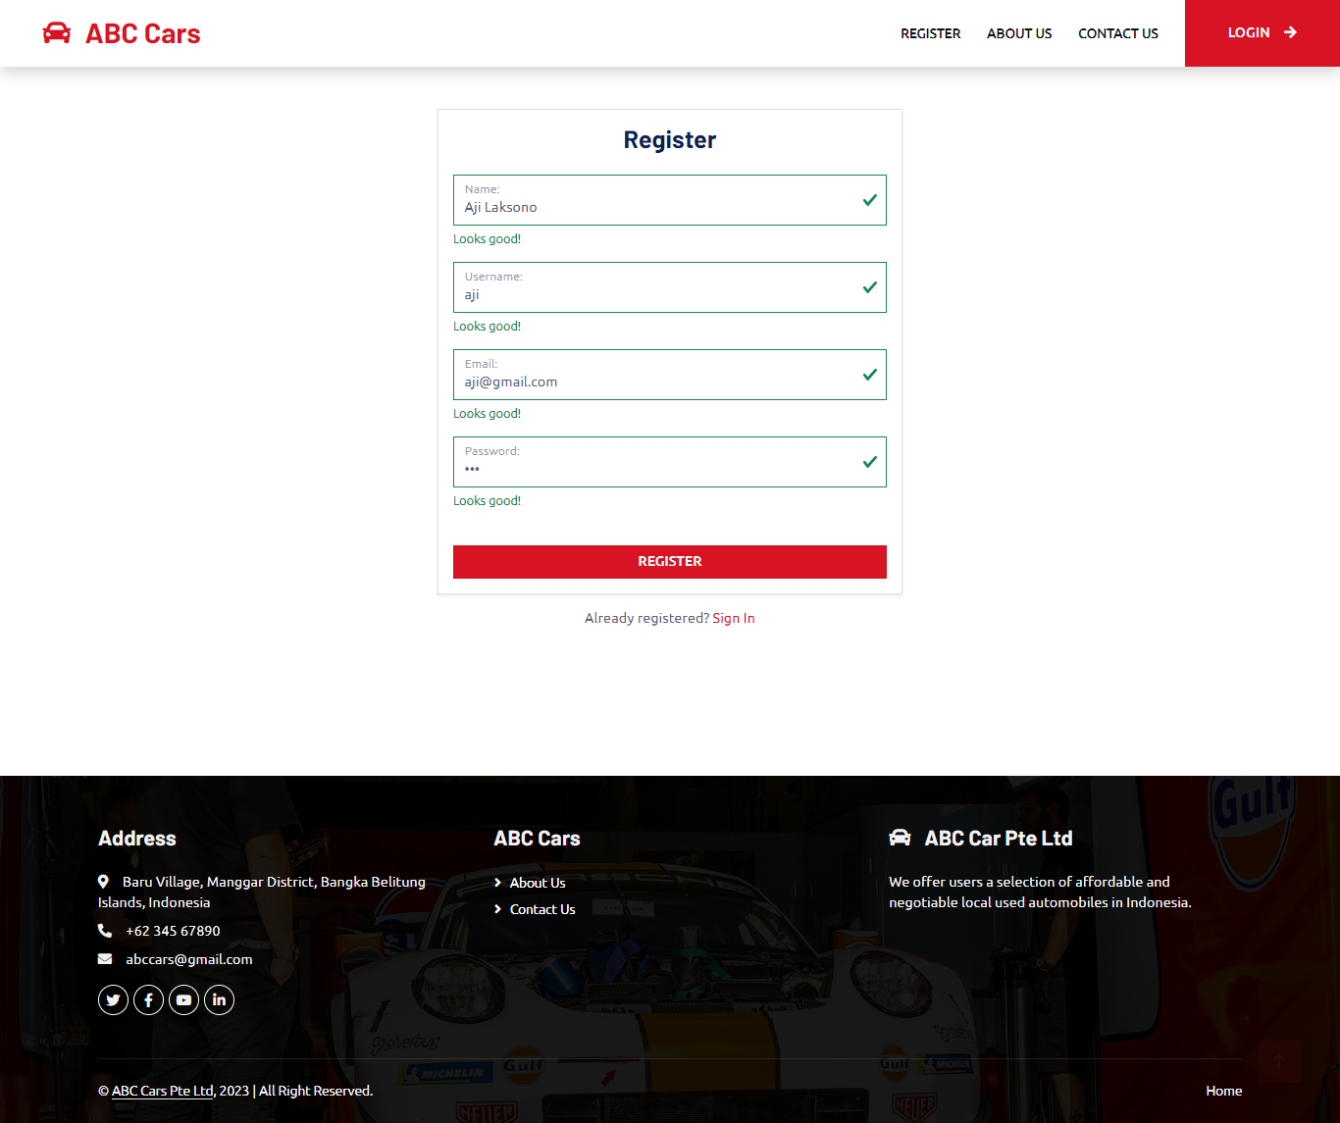
UI screenshot
i. Scenario – registration

Slide 7
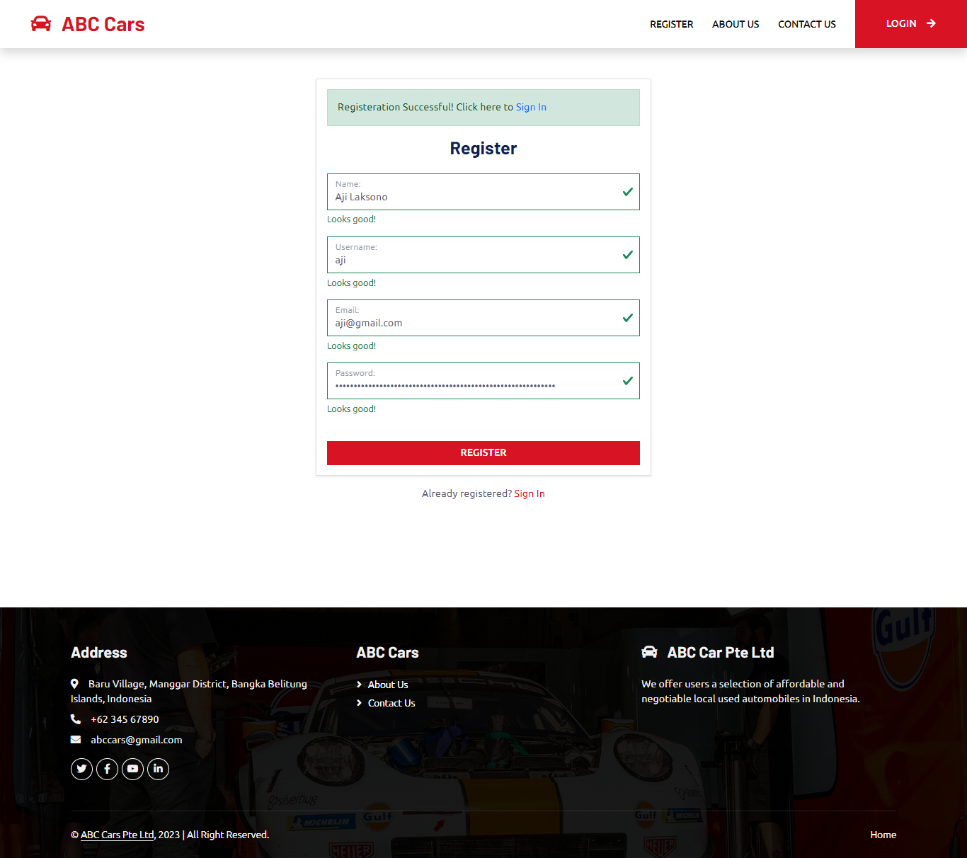

Slide 8
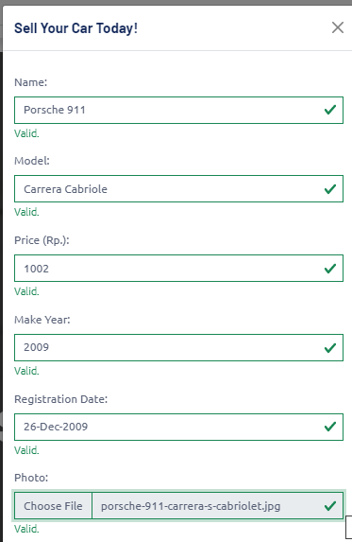

Scenario – post Scenario

Slide 9
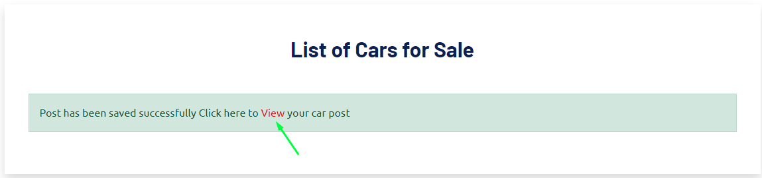
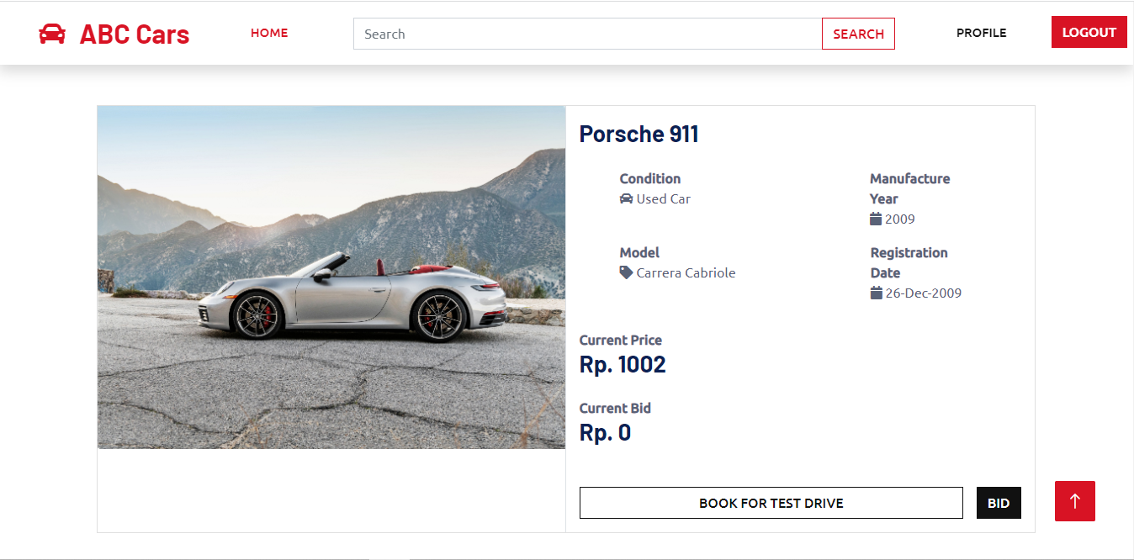

Slide 10
Functionality
Pages | Functionality
Register | to create an account so that users can enter the abc cars portal
Login | Before a user may access the homepage of the ABC Car Portal, their registration credentials, username, and password must be validated.
Home | containing the list of all car posted and post a car sale form
Car Detail | allows the user to view every detail of the a car after listing a new vehicle for sale or using the view car detail button from a list of all vehicles on the homepage.
Search Result | After using the search bar in the header to look up a make, model, registration, or price, the user is directed to a page that displays a list of vehicles matching the search term.
Update Profile | to enable users to edit profile details like their address and phone number. Also, give users the option of tracking posted car sales and booking progress or removing posted car listings.
User Management | allowing an administrator to see a list of users who have registered, selecting a user as an administrator, editing the user's profile, or removing the user
Car management | allowing the administrator to check the list of cars specified, remove a car from the list, change the status of a user's booking based on a bid, or change the status of a car sale
About Us | User-viewed page with information about the ABC Used Car Sales Portal
Contact Us | User-viewed page with contact details for the ABC Used Car Sales Portal company

Slide 11
3. Project Plan

Slide 12
4. Stages of Risk Based Testing model
Risk identifying | Risk Impact Analysis | Risk Mitigating | Risk Monitoring
Various ways to identify risk includes: -Brainstorming -Interviewing The risk can alternatively be divided into three groups, including: • Known risk - Functional risk - Non-functional risk - Technical risk • Unknown risk: appear during testing: - Not enough resources - Delayed testing due to sudden defect appearing - System down for more than 1 day - Natural calamities | The risk matrix can be used by project managers to assess a risk's likelihood of happening and its impact on the project. By assigning each risk a rating on a scale, project managers may determine which dangers need the most attention. It's a tactic to ensure that risks are identified and dealt with methodically and effectively. | After risks have been identified and assessed, a response strategy to handle them must be created. The reaction strategy can either involve eliminating the threat or reducing its effects to a reasonable level. The reduction of risk is what is referred to as risk management in the context of software development. | Monitoring and controlling risks entails examining those that may still exist and recognising any new ones that may appear as the project progresses. In meetings, the team can employ techniques including risk reassessment, auditing, trend analysis, and project status updates to monitor and control risk.

Slide 13
5. Types of risks
Type of risk | Risk identification | Risk description | Impact
Functional | Login risk | The user is not able to log in | Users won't be able to access all the functions the website offers if they cannot log in.
 | Searching risk | The user is not able to search for a car | The user must search manually to find a specific car because it is difficult to do so through the portal.
 | Posting a car risk | The user is not able to post his car | The user is not able to post a car to sale his car in the portal
 | Viewing car detail risk | The user is not able to view selected car details | The user is not able to bid, book, and see the details for a particular car
 | Data is not saved, deleted, or updated in the database | No rows were affected during the operation | Some features or even the entire application will not work properly
Non-Functional Risk | Performance | The home page is not loading in the expected time | The user will lose interest and lose patience to wait, and finally, the user will choose another website that meets the user’s needs
 | Compatibility | The home page has a different look and feel in different browsers | Users will lose interest due to the difference of user interface
 | Maintainability | Used car portal cannot be modified or make changes | Users will judge the portal as not up to date
 | Usability | The portal has no clear labeling or usage instructions, making it difficult to explore. | The software may be challenging for users to understand and operate, which could cause dissatisfaction and eventual product desertion.
Technical Risk | Security | The user is not authenticated correctly after logging in | The user will not be able to log in to the portal and reach the home page
 |  | Navigation is not properly authorized based on the user's login role assigned. | The user will have unauthorized access to sensitive information or functionality.
 |  | SQL injection | It might result in sensitive data loss, data breaches, and system integrity issues.
 | Portability | Used car sale portal look and feel is different in phone/mobile devices | Users who are comfortable with a certain gadget will stop using the website.

Slide 14
6. Risk Based Testing Strategies
Risk Id | Test Scenario ID | Test Scenario | Test Objective | Test Priority | Risk | Technique | Expected Results
1 | UA001 | Ensure user can register in the portal | To allow user to register with their credentials (name, username, email, password) successfully | High | User is not able to register with their credentials | UAT Testing | The user will get a success message and their credentials saved in the database after successfully enrolling.
2 | UA002 | Ensure user can login in the portal | To allow user to login with registered credentials | High | User is not able to log in with registered credentials | UAT Testing | After logging in, the user will see the home page.
3 | UA003 | Ensure user car post a car in the portal | To allow user to post a car in the portal | High | User is not able to post a car in the portal | UAT Testing | The platform allows users to post their cars.
4 | UA004 | Ensure user can search and view car detail | To allow user to search a particular car in the portal | High | User is not able to find the expected car | UAT Testing | The user will see a matched search result after entering the keyword.
5 | UA005 | Ensure user can update his profile | To allow user to update their profile | High | Users is not able to update their profile | UAT Testing | Users' profiles can now display updated information.

Slide 15
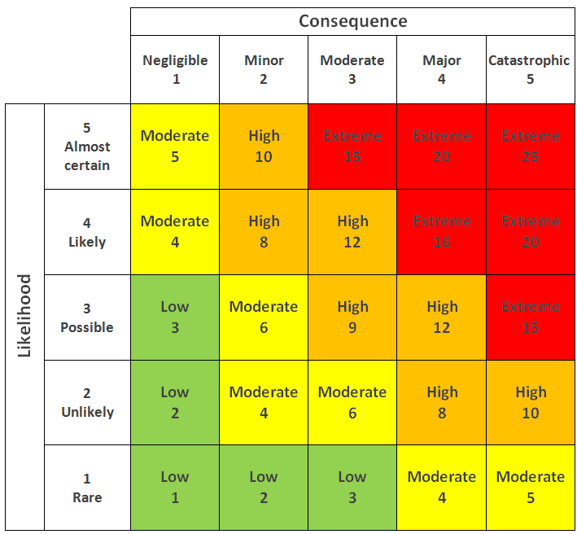
6. Risk Based Testing Strategies
Risk ID | Risk | Likelihood (1-5) | Impact (1 – 5) | Type of Testing | Risk Rating | Risk Level
1 | User is not be able register in the system | 3 | 4 | UAT Testing | 12 | High
2 | User will not be able to reach the home page to post or view cars | 3 | 4 | UAT Testing | 12 | High
3 | User not be able to sell their car | 3 | 4 | UAT Testing | 12 | High
4 | User will not be able to find the car excepted | 3 | 4 | UAT Testing | 9 | High

Slide 16
6. Risk Based Testing Strategies
Risk Analysis
-Identify all possible risk -Categorize the risk into functional , technical and , non functional risk. Assess the risk level using the risk matrix Prioritize the extreme high risk
Test planning
SDLC Model, spiral model is selected Test plan and schedule are prepared tn the basis of risk assesment
Test Execution
Test execution is …… UAT Unit Performance Compability Portability Usability security

Slide 17
7.Qualitative and Quantitative Risk Analysis
Qualitative Risk Analysis | Quantitative Risk Analysis
- Qualitative risk analysis is subjective Predict risk severity by likelihood and impact using a risk assessment matrix Lacking numeral estimate for fund or budget | - Quantitative risk analysis is objective Include prioritized list of risk done using a risk matrix Includes reliable data such as completion Time ,schedule, budget resources and so on

Slide 18
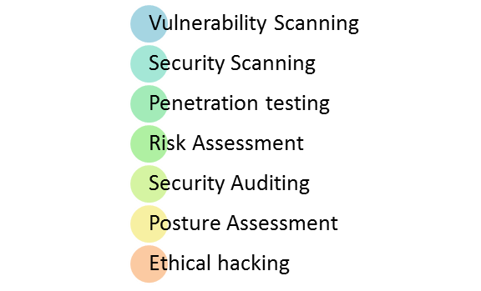
8. Security Testing
Security Testing is a form of software testing
- What is security testing
The software testing that focuses on finding vulnerabilities and faults in a system or application’s security mechanisms is known as security testing. To ensure that the system or application is protected against potential threats, including unauthorized access, hacking, data breaches, and other cyber-attacks, security testing is conducted.
-Types of security testing
- How it is conducted- Authentication, Authorization, SQL injection.
- To ensure that the system only permits authorized users to access it, authentication testing is done by attempting to get into the system using multiple credentials, such as legitimate and illegitimate usernames and passwords.
To make sure that the system only permits authorized users to access certain resources or take certain actions, authorization testing is carried out by trying to access those resources or do those actions.
To test whether the system can recognize and thwart these attacks, malicious SQL code is intentionally injected into the system.

Slide 19
9. Test plans and Test cases
Test plan : A Test Plan is a concept and deliverable that defines the strategy that will be used to verifiy that the product or system is develoved according to its specification and requirement.
Test case : Test case consist of test case name , precondition , steps / input condition , excepted result .
Functional testing
UAT-
2. Unit testing
2. Performance testing
Requiment | Test Scenario ID | Test Scenario | Number of test test Cases
Functional Testing | UA001 – UAT Testing | Ensure user can register in the portal | 1
Requiment | Test Scenario ID | Test Scenario | Number of test test Cases
Functional Testing | TS001 – Unit Testing | Validating registration functionality | 1
Requiment | Test Scenario ID | Test Scenario | Number of test test Cases
Functional Testing | PM001 – Performance testing | Testing performance of registration | 1

Slide 20
UAT Testing
Test Scenario ID | Test Case ID | Test Case | Pre-condition | Expected Result | Actual Result | Pass/ Fail
UA001 | UATC001 | Check all the mandatory fields are entered | ABC Cars Portal website has completed and uploaded on server | After registering, user will see a successful registration message and a login link. | Result is come out as expected | Pass
Test data and steps | Name= Stephen Curry Username = curry Email= curry@gmail.com Password= curry 1. Enter URL localhost:8080 2. Click “Register” on website navigation bar 3. Enter all the fields. 4. Click Register.

Slide 21
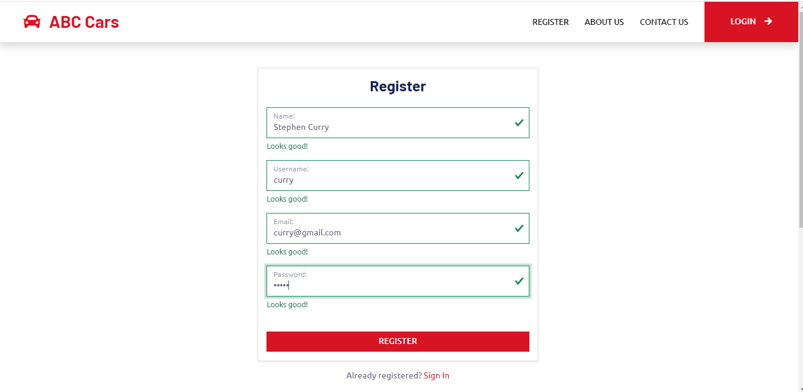
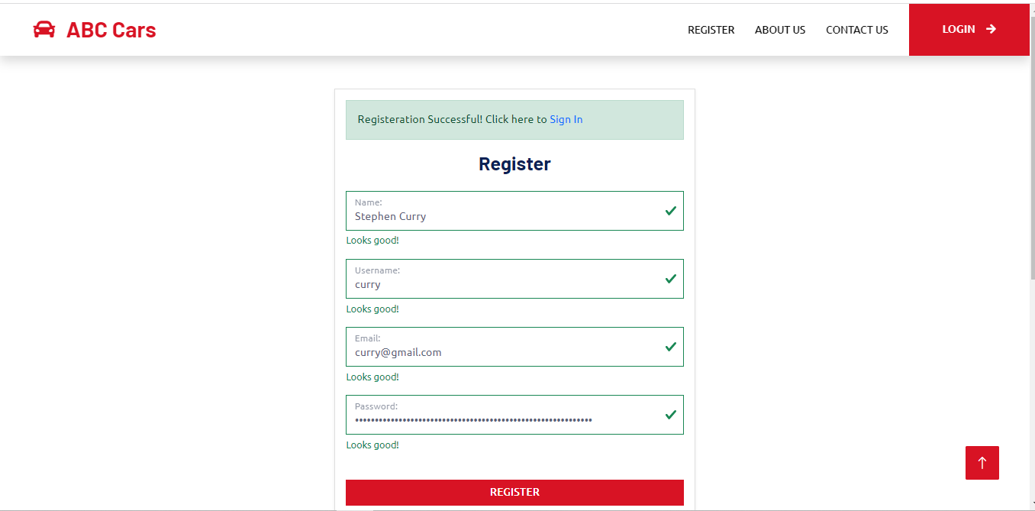
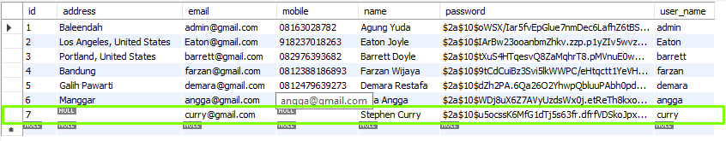

Slide 22
Unit Testing
Test Scenario ID | Test Case ID | Test Case | Pre-condition | Expected Result | Actual Result | Pass/ Fail
TS001 | TC001 | Check if registered data can be saved | ABC Cars Portal website has completed and uploaded on server | After checking, junit should return a passing result as user data can be save | Not as expected | fail
Test Step & Test data | Name= Anggun Nazhuha Username = anggun Email= anggun@gmail.com Password= anggun 1. Run Test script shown in screenshot below

Slide 23
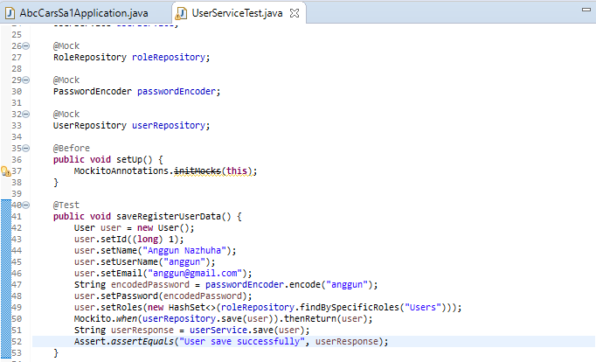
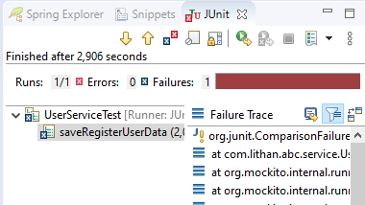

Slide 24
Performance Testing
Test Scenario ID | Test Case ID | Test Case | Pre-condition | Expected Result | Actual Result | Pass/ Fail
PM001 | PMC001 | To test the loading time speed of the registration page using Chrome DevTools | ABC Cars Portal website has completed and uploaded on server | After testing, The loading time is expected to be less than 1s. | Result is come out as expected | Pass
Test Step & Test data | 1. Enter URL localhost:8080 2. Use Chrome DevTools by right click and choose inspect 3.Click Network, choose No throttling, Fast 3G, Slow 3G 4. Click “Register” on website navigation bar

Slide 25
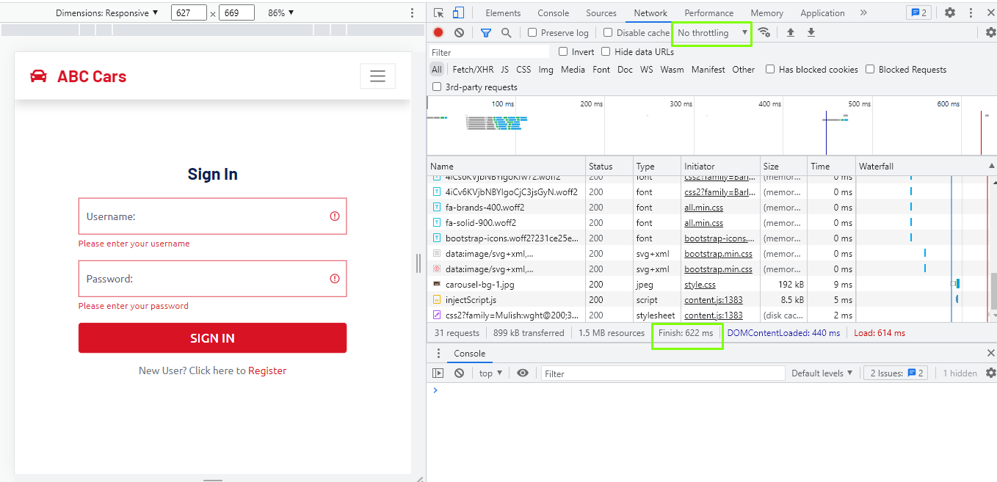

Slide 26
10. Logs of Test Results
 | Used Car Sale Portal Project
Reported By: | Agung Yuda Pratama
Report Date: | 29/04/2023
Tested By: | Agung Yuda Pratama
Tested Date: | 29/04/2023
Testing Name/ Test Scenario ID | Functional testing: -Unit Testing/ TS001 / TS002 / TS003 / TS004 /TS005
Total Number of Test Cases | 5
No. of Pass: | 4
No. of Failures: | 1
Elapsed Time: | 00:30:00
Tested By: | Agung Yuda Pratama
Tested Date: | 29/04/2023
Testing Name/ Test Scenario ID | Functional testing: -UAT Testing/ UA001 / UA002 / UA003 / UA004 /UA005
Total Number of Test Cases | 10
No. of Pass: | 9
No. of Failures: | 1
Elapsed Time: | 00:30:00
Tested By: | Agung Yuda Pratama
Tested Date: | 29/04/2023
Testing Name/ Test Scenario ID | Performance Testing/ PM001
Total Number of Test Cases | 2
No. of Pass: | 2
No. of Failures: | 0
Elapsed Time: | 00:10:00
Tested By: | Agung Yuda Pratama
Tested Date: | 29/04/2023
Testing Name/ Test Scenario ID | Compatibility Testing/ CB001 / CB002 / CB003 / CB004 / CB005
Total Number of Test Cases | 15
No. of Pass: | 15
No. of Failures: | 0
Elapsed Time: | 00:40:00

Slide 27
10. Logs of Test Results
Tested By: | Agung Yuda Pratama
Tested Date: | 29/04/2023
Testing Name/ Test Scenario ID | Usability Testing/ UB001/ UB002/UB003/UB004/UB005
Total Number of Test Cases | 5
No. of Pass: | 5
No. of Failures: | 0
Elapsed Time: | 00:20:00
Tested By: | Agung Yuda Pratama
Tested Date: | 29/04/2023
Testing Name/ Test Scenario ID | Security Testing/ SE001/ SE002/ SE003
Total Number of Test Cases | 5
No. of Pass: | 5
No. of Failures: | 0
Elapsed Time: | 00:20:00
Tested By: | Agung Yuda Pratama
Tested Date: | 29/04/2023
Testing Name/ Test Scenario ID | Portability Testing/ PB001
Total Number of Test Cases | 3
No. of Pass: | 3
No. of Failures: | 0
Elapsed Time: | 00:30:00
SUMMARY LOG STATUS
Total Number of Test Cases | 45
Total Number of Pass | 43
Total Number of Failures | 2
Pass % | 95%
Total Elapsed Time | 03:00:00

Slide 28
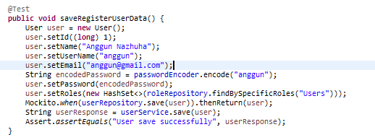
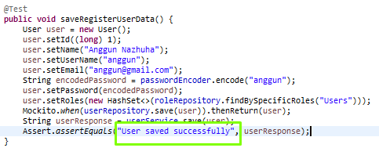
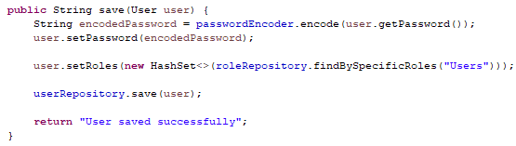
11.Modification of fail test cases
Modification to source code for unit testing failed cases
Before modification
After modification

Slide 29
Re testing for unit testing test case
Test Scenario ID | Test Case ID | Test Case | Pre-condition | Expected Result | Actual Result | Pass/ Fail
TS001 | TC001 | Check if registered data can be saved | ABC Cars Portal website has completed and uploaded on server | After checking, junit should return a passing result as user data can be save | as expected | pass
Test Step & Test data | Name= Anggun Nazhuha Username = anggun Email= anggun@gmail.com Password= anggun

Slide 30
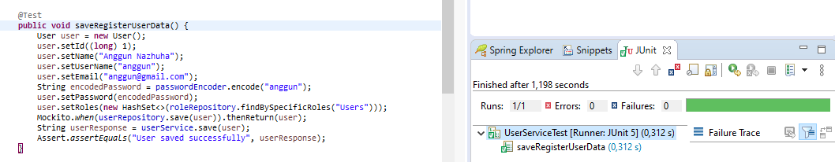
After modification

Slide 31
11.Modification of fail test cases
Log Result after modification
Project ID/ Project Name: | Used Car Sale Portal Project
Reported By: | Agung Yuda Pratama
Report Date: | 29/04/2023
Tested By: | Agung Yuda Pratama
Tested Date: | 29/04/2023
Testing Name/ Test Scenario ID | Functional Testing/ TS001
Total Number of Test Cases | 1
No. of Pass: | 1
No. of Failures: | 0
Elapsed Time: | 00:17:00
Tested By: | Agung Yuda Pratama
Tested Date: | 29/04/2023
Testing Name/ Test Scenario ID | UAT Testing/ UA004
Total Number of Test Cases | 1
No. of Pass: | 1
No. of Failures: | 0
Elapsed Time: | 00:17:00
SUMMARY LOG STATUS
Total Number of Test Cases | 2
Total Number of Pass | 2
Total Number of Failures | 0
Pass % | 100%
Total Elapsed Time | 00:17:00

Slide 32
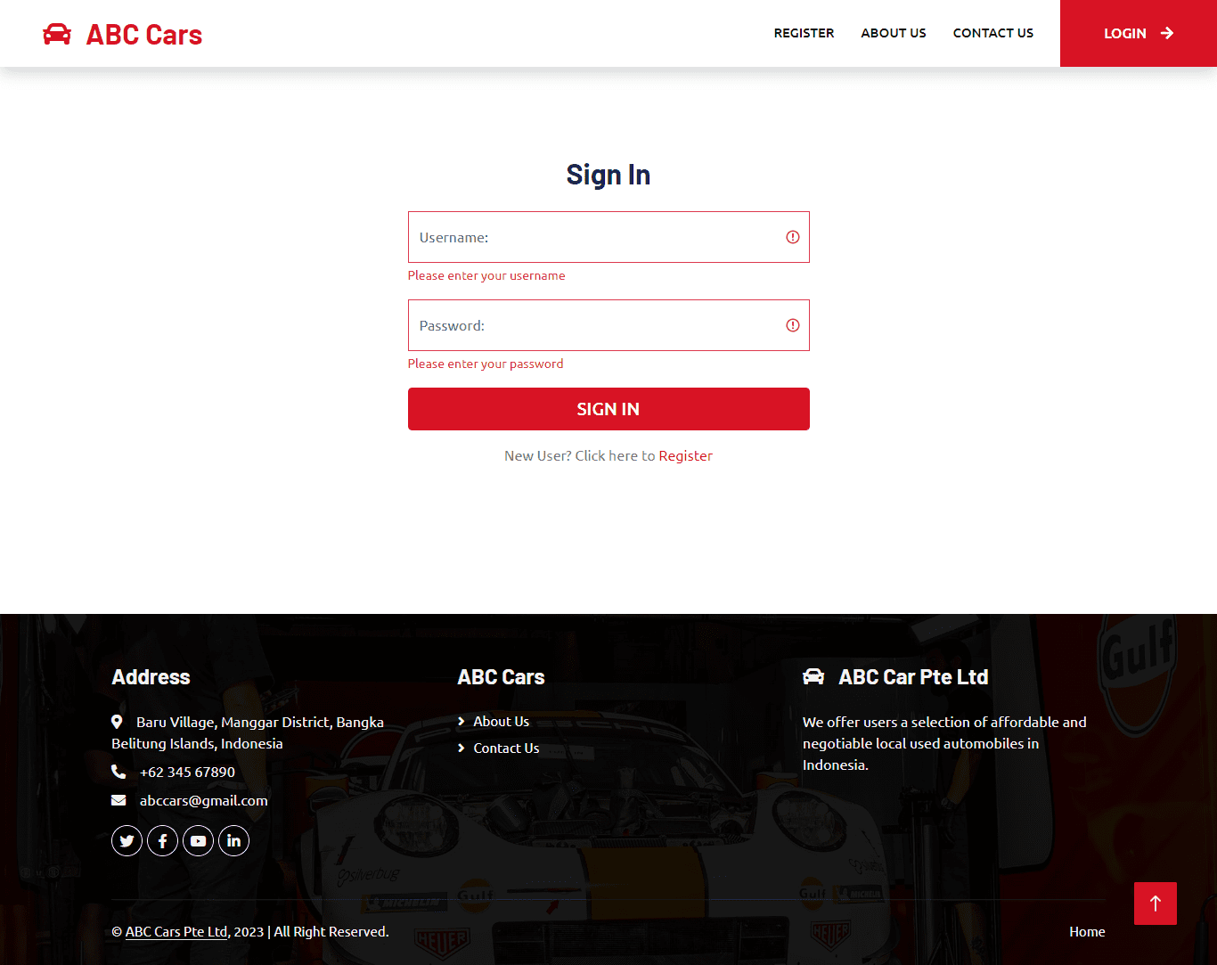
12. Project Results
Provide Screen Capture of Developed Pages

Slide 33
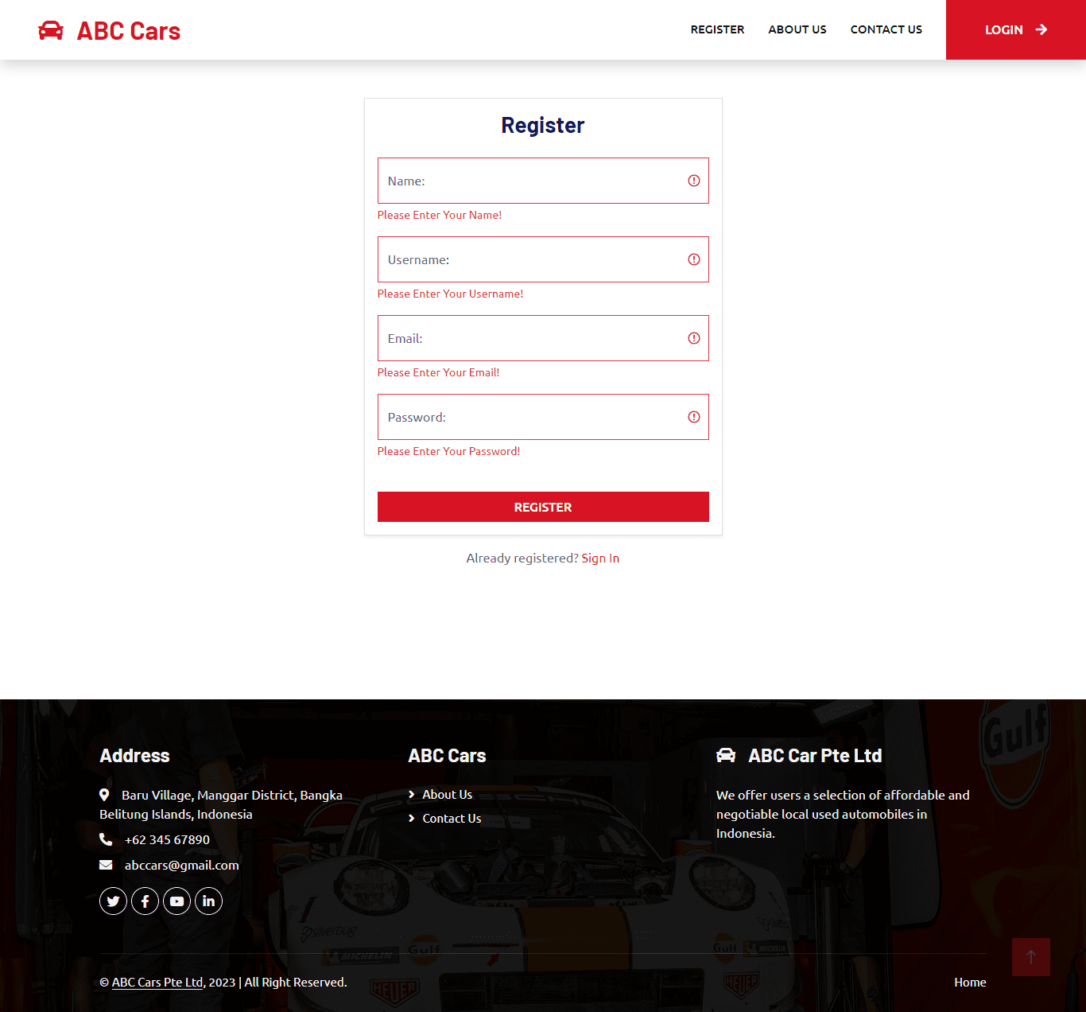
13. Project Results
Provide Screen Capture of Developed Pages

Slide 34
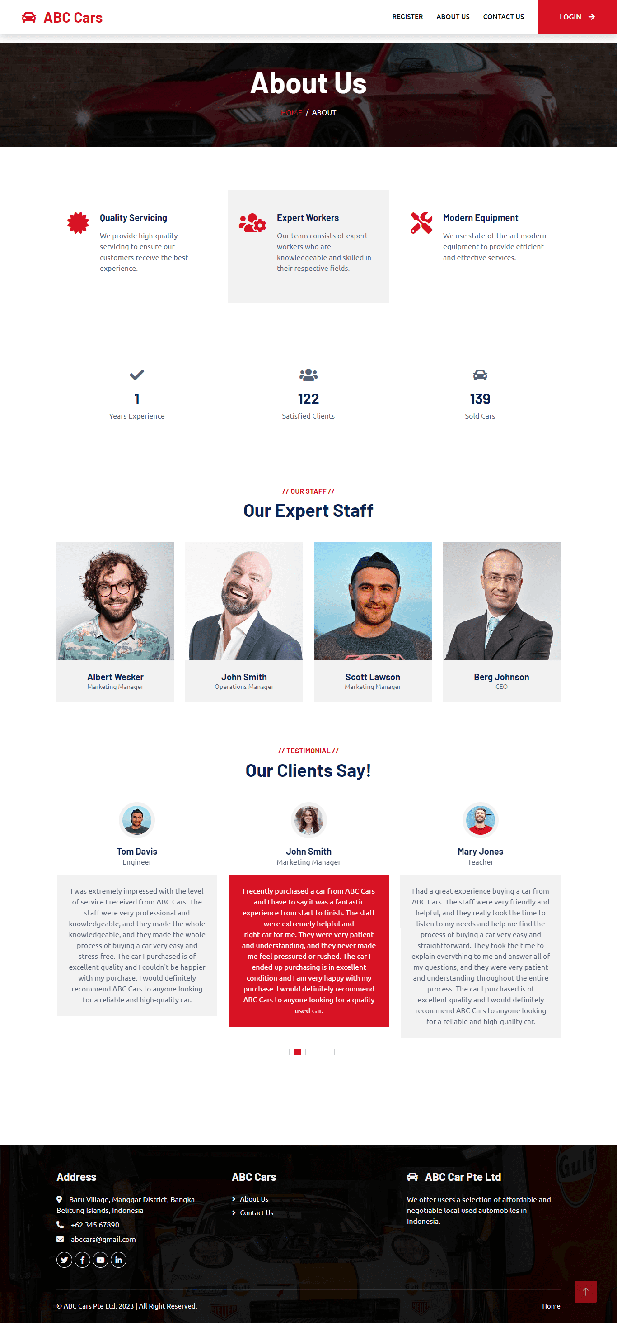
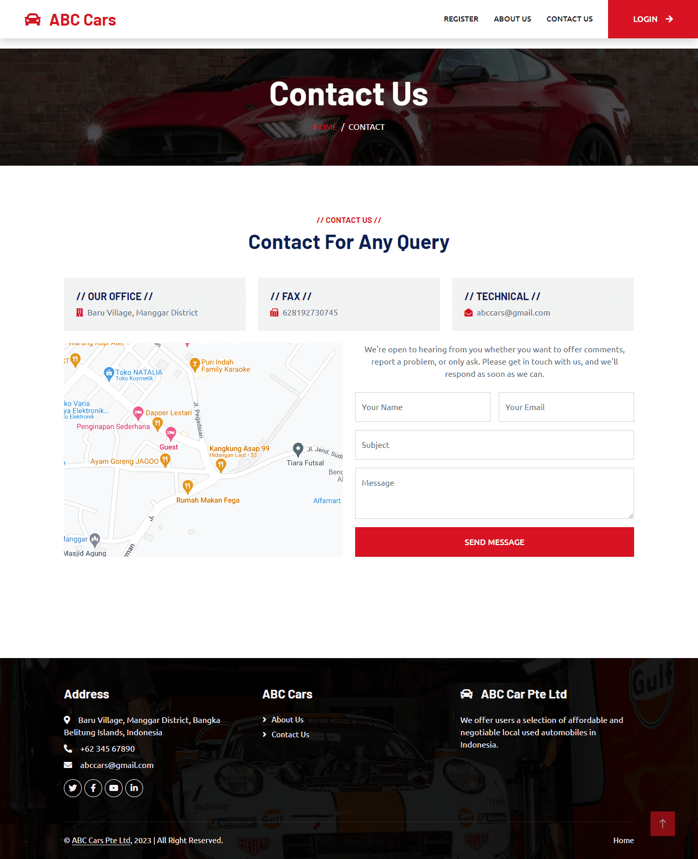
13. Project Results
Provide Screen Capture of Developed Pages

Slide 35
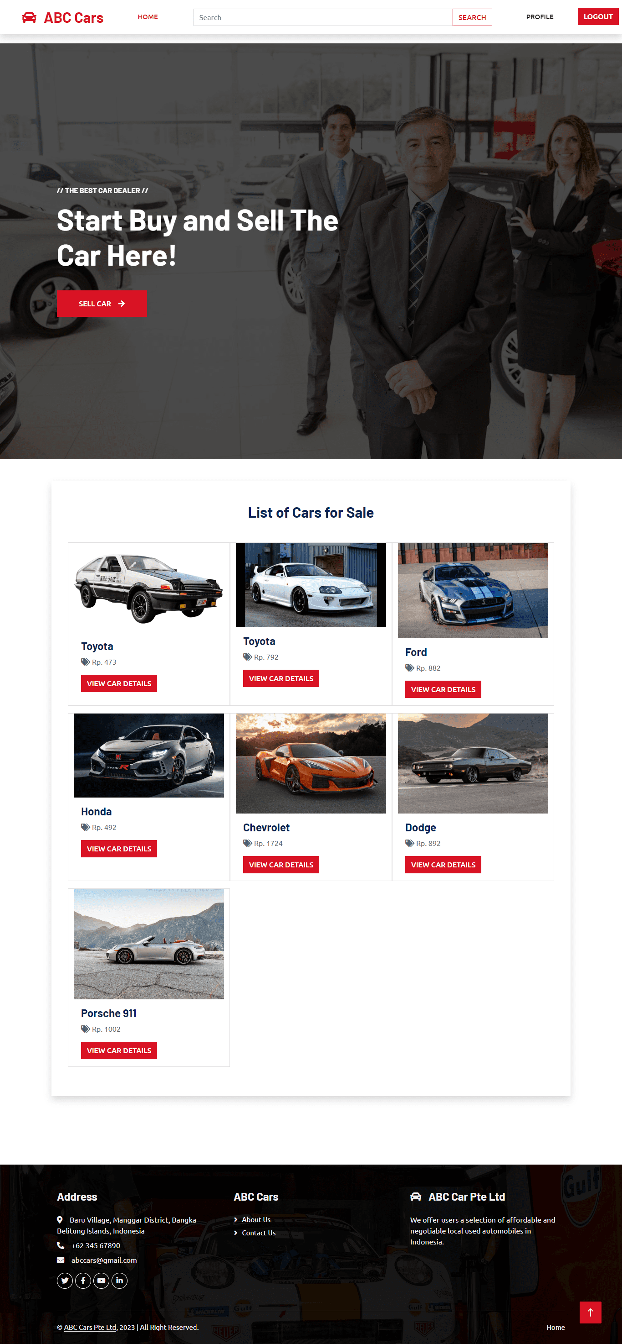
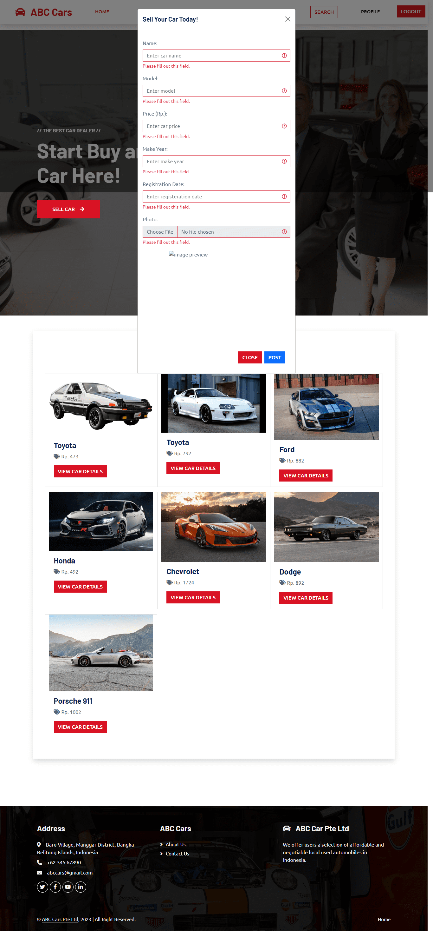
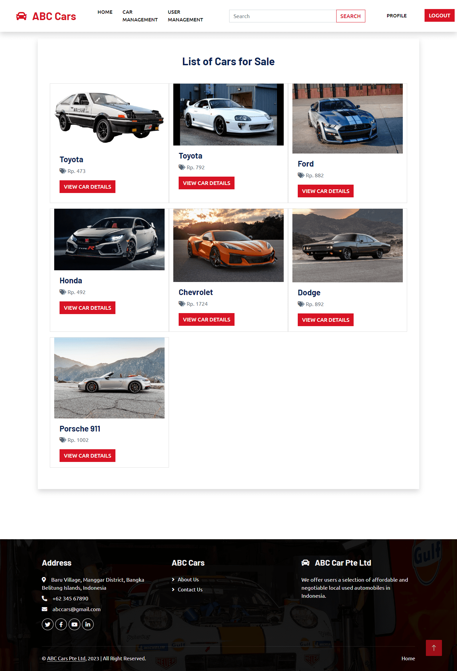
13. Project Results
Provide Screen Capture of Developed Pages

Slide 36
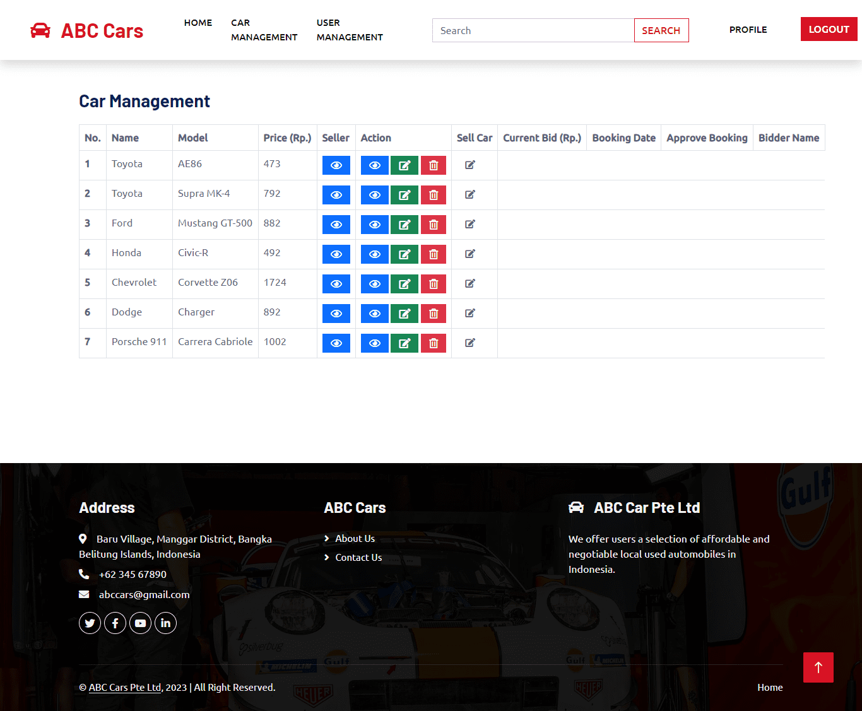
13. Project Results
Provide Screen Capture of Developed Pages

Slide 37
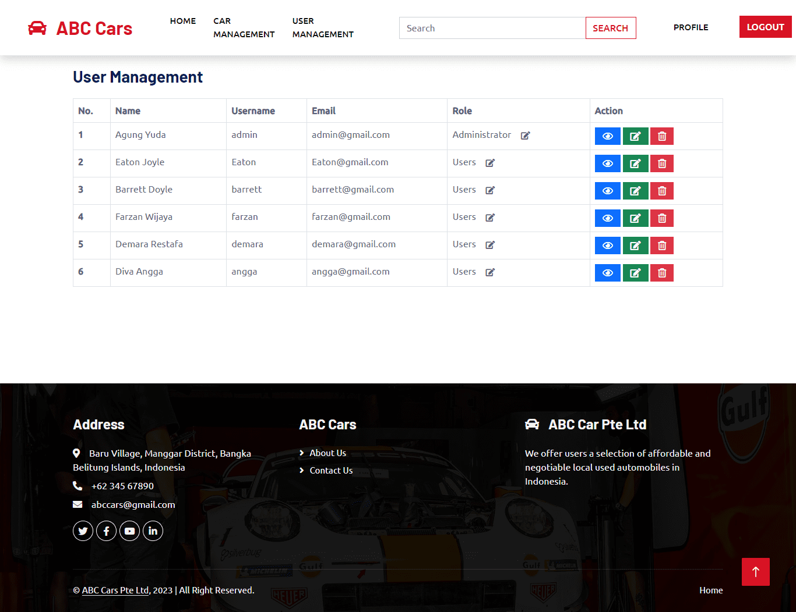
13. Project Results
Provide Screen Capture of Developed Pages

Slide 38
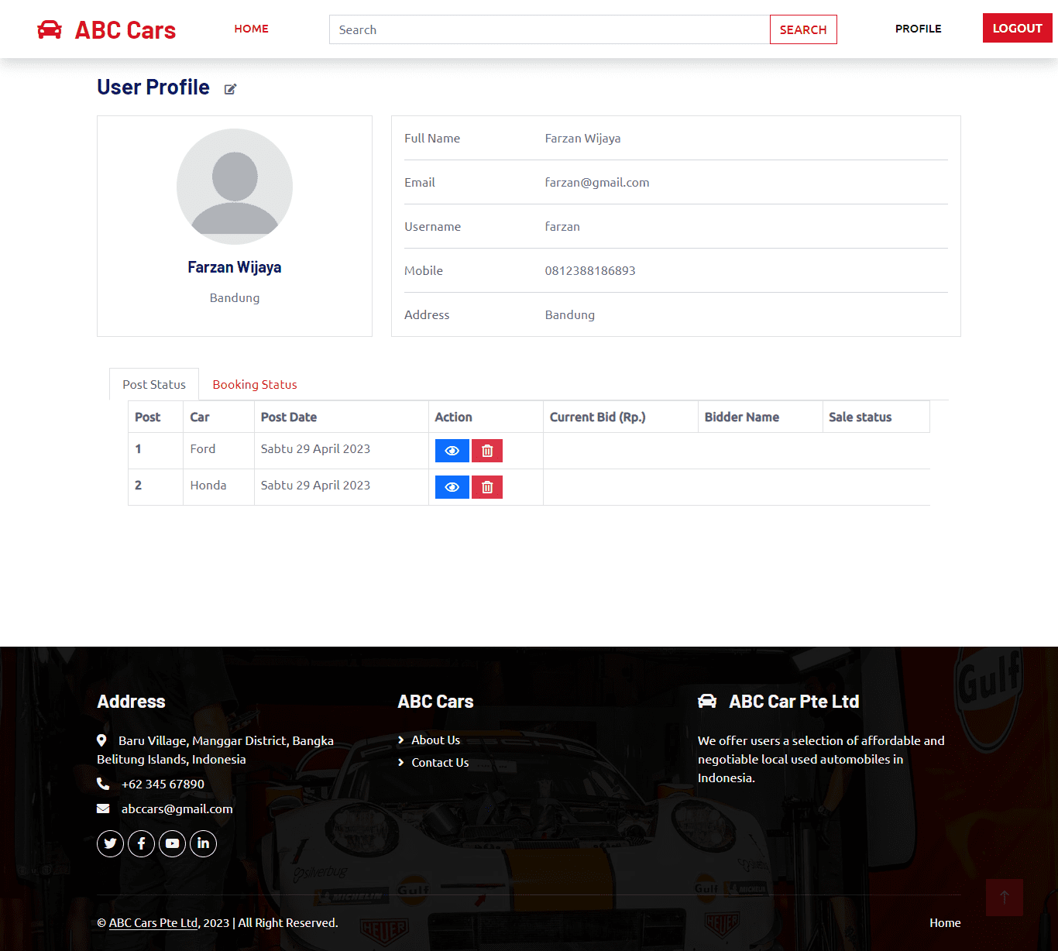
13. Project Results
Provide Screen Capture of Developed Pages

Slide 39
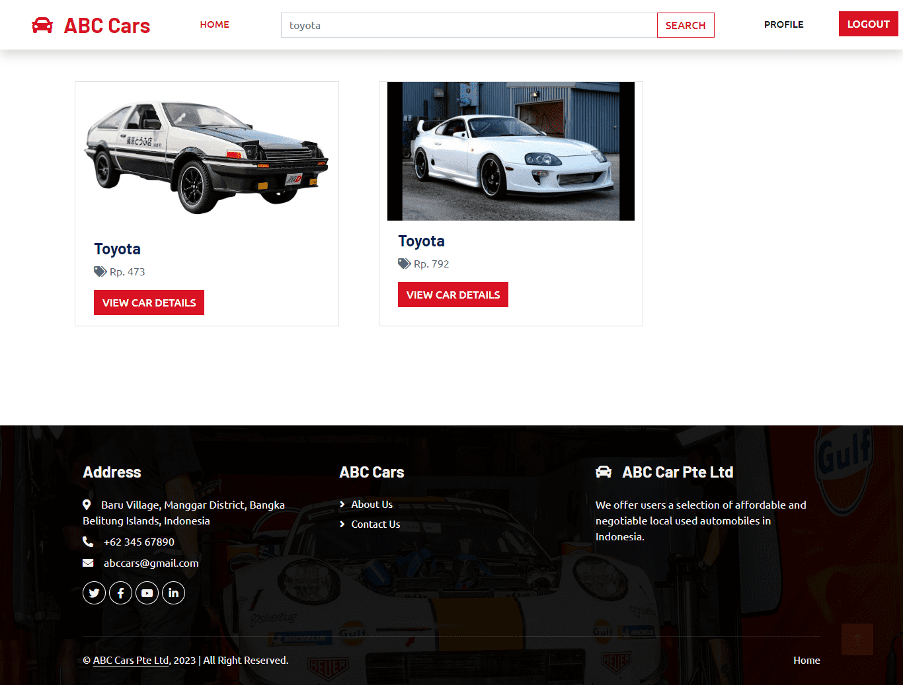
13. Project Results
Provide Screen Capture of Developed Pages

Slide 40
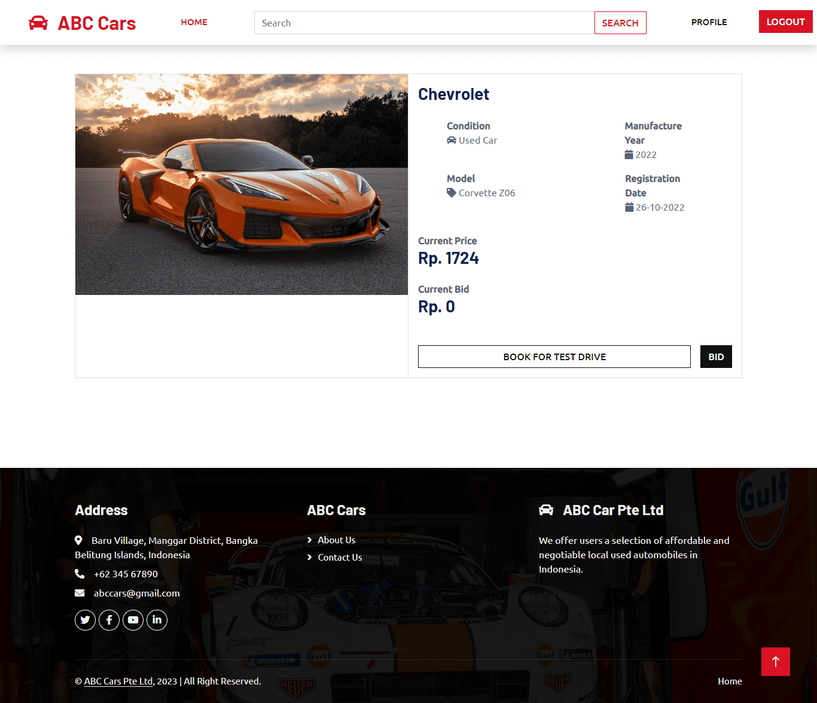
13. Project Results
Provide Screen Capture of Developed Pages

